Slide 1

2.1.4 Geometric interpretation of real higher-dimensional vectors

Slide 2
Introduction
In this topic, we will
  Discuss the issues of visualizing 4-dimensional vectors
  Consider interpretations of higher-dimensional vectors

Slide 3

4-dimensional vectors
It is interesting to interpret a 4th entry as time
  This vector is 1.3 seconds into the future
v

Slide 4
4-dimensional vectors
It is interesting to interpret a 4th entry as time
  This vector occupies this point in the present
v

Slide 5

n-dimensional vectors
Instead, after 3 dimensions,
it is better to think of an n-dimensional vector
as a function of n integers
v

Slide 6
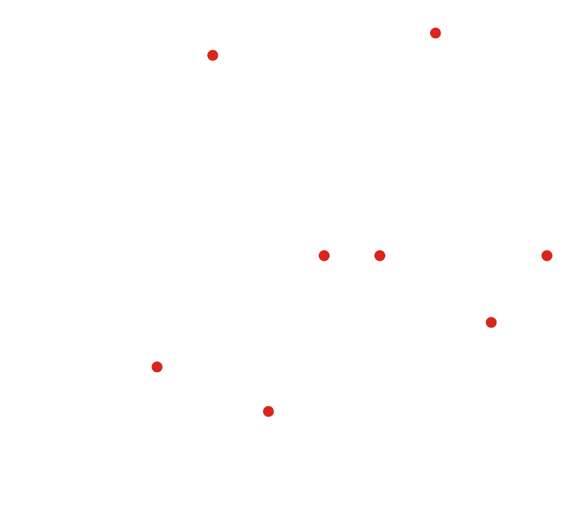
n-dimensional vectors
If you must visualize such a point in 8 dimensions,
here is one such visualization

Slide 7
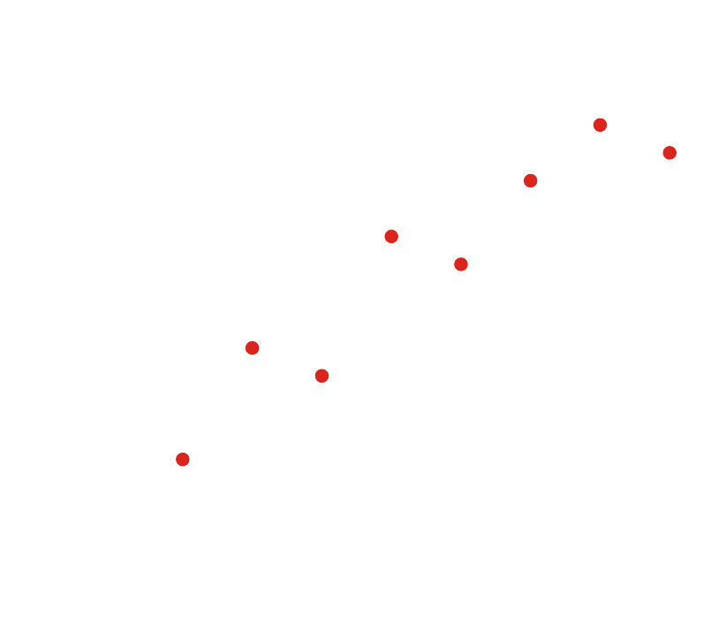
n-dimensional vectors
If you must visualize such a point in 8 dimensions,
here is one such visualization

Slide 8
n-dimensional vectors
In general, however, it is best to think of vectors as ordered information
  Don’t spend too much time trying to visualize vectors
  Each entry of the vector represents something in the real world

Slide 9
Summary
Following this topic, you now
  Seen interpretations of 4-dimensional vectors
  Seen a possible interpretation of higher-dimensional vectors
  Understand this is useful only if there is some sort of periodic relationship between the values
    Temporal or spatial

Slide 10
References
[1] https://en.wikipedia.org/wiki/Linear_algebra

Slide 11
Acknowledgments
None so far.

Slide 12



Colophon
These slides were prepared using the Cambria typeface. Mathematical equations use Times New Roman, and source code is presented using Consolas.
The photographs of flowers and a monarch butter appearing on the title slide and accenting the top of each other slide were taken at the Royal Botanical Gardens in October of 2017 by Douglas Wilhelm Harder. Please see
https://www.rbg.ca/
for more information.

Slide 13
Disclaimer
These slides are provided for the ne 112 Linear algebra for nanotechnology engineering course taught at the University of Waterloo. The material in it reflects the authors’ best judgment in light of the information available to them at the time of preparation. Any reliance on these course slides by any party for any other purpose are the responsibility of such parties. The authors accept no responsibility for damages, if any, suffered by any party as a result of decisions made or actions based on these course slides for any other purpose than that for which it was intended.

